Slide 1
Smart Learn AI An Intelligent AI-Powered Study Assistant for Personalised Learning
CAPSTONE PROJECT
Presented By:
C PUSHPALATHA
JUSTICE BASHEER AHMED SAYEED COLLEGE FOR WOMEN
MASTER OF COMPUTER APPLICATIONS
AICTE Student ID: STU696132c929d891767977673

Slide 2
OUTLINE
Problem Statement (Should not include solution)
Proposed System/Solution
System Development Approach (Technology Used)
Algorithm & Deployment
Result
Conclusion
Future Scope
References

Slide 3
Problem Statement
Students often struggle to understand complex concepts, prepare concise study notes, revise effectively, and assess their knowledge. Existing study methods require switching between multiple platforms for concept explanation, summarisation, revision, and quiz preparation, making the learning process time-consuming and less interactive.

Slide 4
Proposed Solution
Overview
SmartLearn AI is an AI-powered educational platform developed using Python, Streamlit, and the Google Gemini API.
It provides students with an intelligent and interactive learning environment that simplifies studying and enhances knowledge retention
Concept Clarification
The system explains complex topics in a simple and structured manner. Users can either enter a concept or upload a PDF document, and the AI generates easy-to-understand explanations with real-world analogies and key insights.
Intelligent Note Summarisation
Students can upload lecture notes or PDF documents to automatically generate concise summaries, important concepts, key terms, and common mistakes, reducing study time while improving understanding.
Flashcard Generation
The application automatically creates AI-powered flashcards from the selected topic, enabling active recall and efficient revision through question-and-answer learning.
Practice Quiz Generation
SmartLearn AI generates multiple-choice quizzes based on user-selected topics.
It evaluates user responses instantly, provides explanations for each answer, and displays the final score to assess learning progress.
Interactive User Interface
The application is built with Streamlit, offering a responsive, user-friendly interface with organized learning modules, PDF upload support, and real-time AI-generated educational content.
Expected Benefits
Reduces manual study effort.
Improves concept understanding.
Enhances revision through flashcards.
Enables self-assessment with AI-generated quizzes.
Supports personalised and efficient learning

Slide 5
System Approach
Requirement Analysis
The project requirements were identified by analyzing the challenges faced by students in understanding concepts, preparing study notes, revising topics, and evaluating their learning.
The objective was to develop a single AI-powered platform that integrates all these educational functionalities.
System Design
A modular architecture was adopted to improve maintainability and scalability. The application consists of four independent modules:
Concept Clarifier
Note Summarizer
Flashcard Generator
Practice Quiz Generator
Each module communicates with the Google Gemini AI model to generate intelligent educational content.
Technology Stack
Programming Language: Python
Frontend Framework: Streamlit
Artificial Intelligence: Google Gemini 2.5 Flash API
Libraries: Streamlit, Google GenAI SDK, JSON
Input Formats: Text and PDF Documents
Implementation
The application was implemented using Streamlit to provide an interactive web interface.
User inputs are processed and sent to the Gemini AI model, which generates explanations, summaries, flashcards, or quizzes.
The generated results are displayed instantly within the application.
Testing
Each module was tested using different topics and PDF documents to verify the accuracy of AI-generated responses, proper PDF processing, quiz evaluation, and overall system performance.

Slide 6
Algorithm & Deployment
User Authentication
The user launches the SmartLearn AI application.
Module Selection
The user selects one of the available learning modules:
Concept Clarifier
Note Summarizer
Flashcards
Practice Quiz
Input Submission
The user enters a topic or uploads a PDF document
Data Processing
The application validates the input and prepares the request.
AI Processing
The processed input is sent to the Google Gemini API, where the AI model analyzes the content and generates the required educational output.
Result Generation
The AI returns:
Concept explanations
Summaries
Flashcards
Quiz questions
Output Display
The generated content is displayed through the Streamlit interface. For quizzes, answers are evaluated and the final score is calculated.
Deployment
The SmartLearn AI application is developed using Python and deployed through the Streamlit framework, making it accessible via a web browser.
It integrates the Google Gemini 2.5 Flash API to generate AI-powered explanations, summaries, flashcards, and quizzes in real time.
The system can be deployed locally for development or hosted on Streamlit Community Cloud for online access by students.
.

Slide 7
Result
The SmartLearn AI application was successfully developed and tested. It accurately generated AI-powered concept explanations, note summaries, flashcards, and practice quizzes based on user input or uploaded PDF documents. The system provided an interactive learning experience, reduced study time, and improved students' understanding and self-assessment through real-time AI-generated educational content.

Slide 8
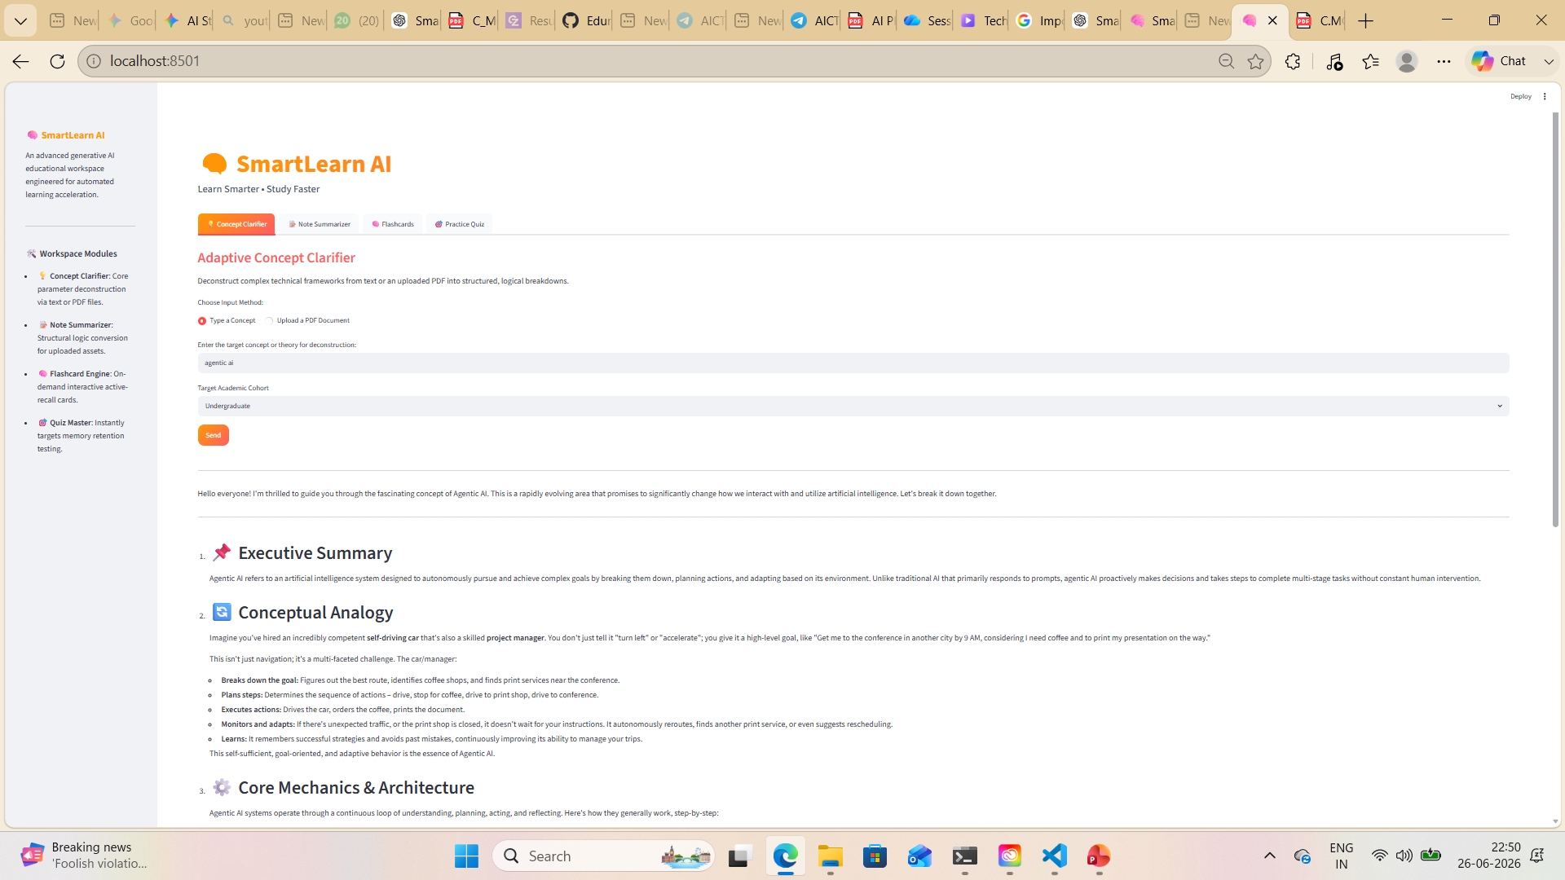
Result

Slide 9
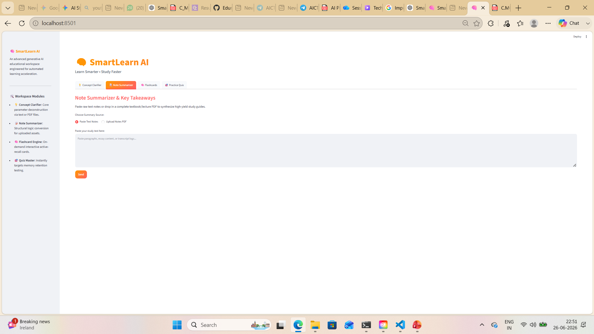
Result

Slide 10
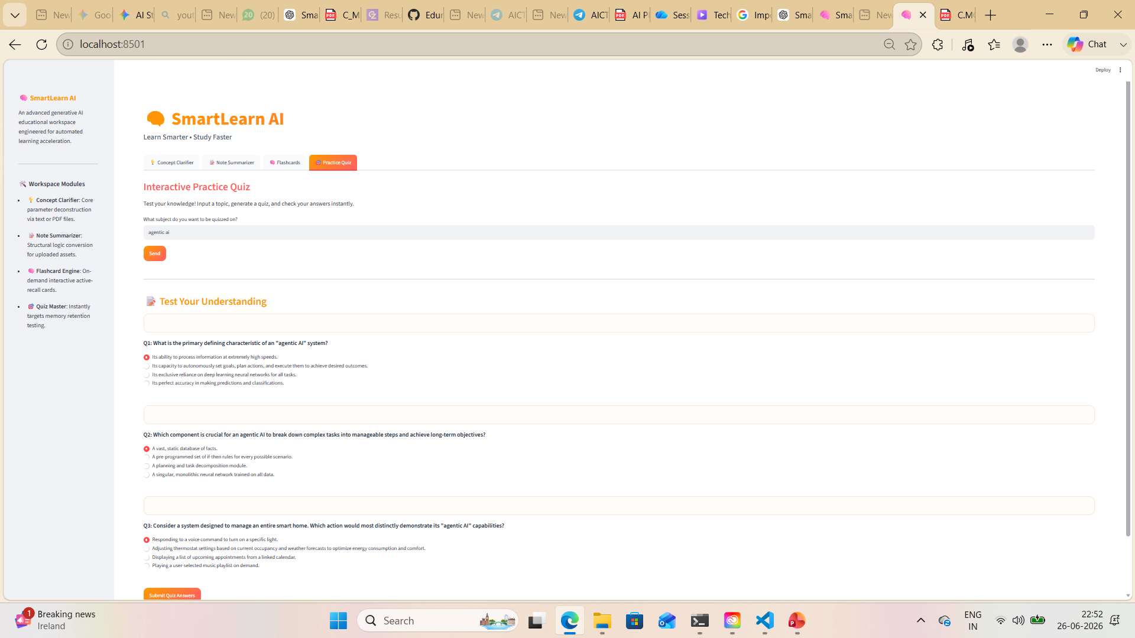
Result

Slide 11
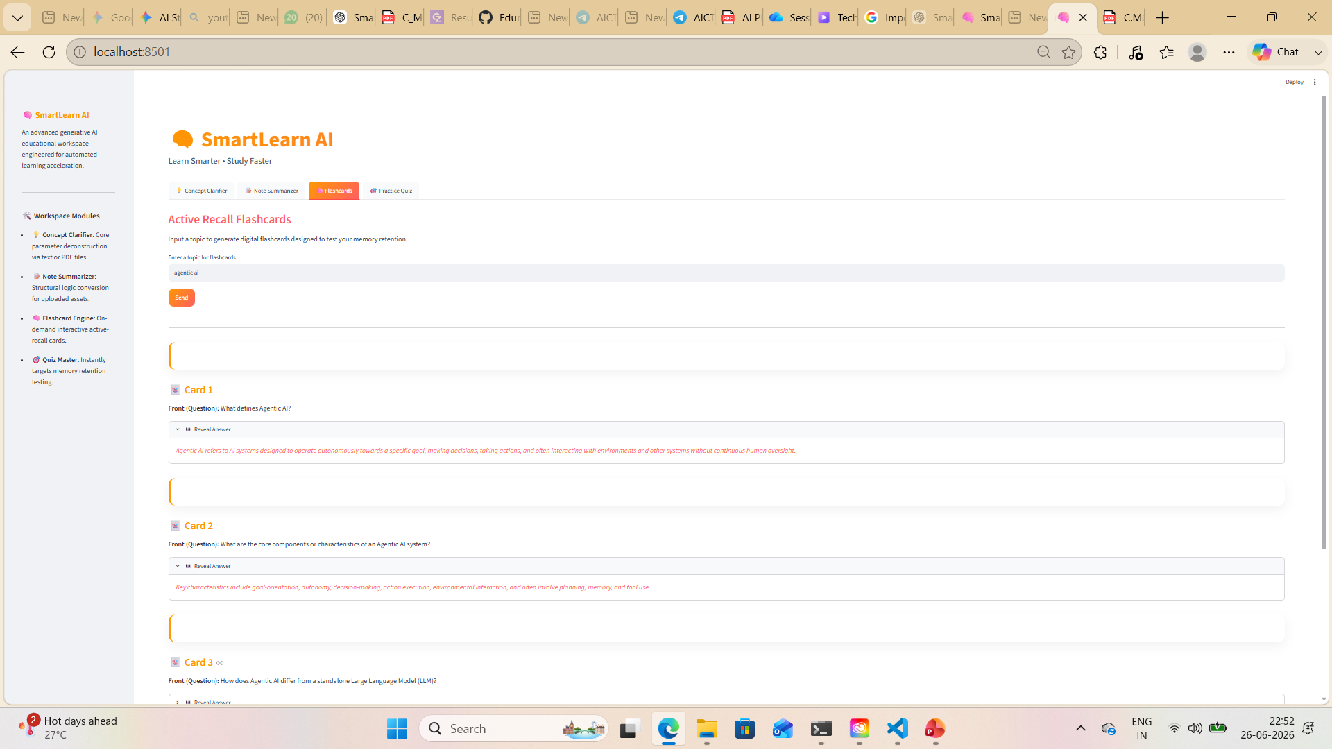
Result

Slide 12
Conclusion
SmartLearn AI integrates Generative AI into education by providing a single platform for concept learning, note summarisation, revision, and self-assessment. The application reduces manual effort, improves study efficiency, and promotes personalised learning through AI-assisted educational support.

Slide 13
Future scope
Voice Assistant Integration
Speech-to-Text
Learning OCR for Handwritten Notes
AI-Based Study Planner
Learning Progress Dashboard
Student Login System
Cloud Database Integration
Mobile Application Development
Multi-language Support Performance Analytics.

Slide 14
References
Streamlit • A faster way to build and share data apps
Welcome to Python.org
Google Gemini API Documentation
https://ai.google.dev/
Streamlit Documentation
https://docs.streamlit.io/
Python Official Documentation
https://docs.python.org/3/
Google GenAI Python SDK Documentation
https://googleapis.github.io/python-genai/
JSON Documentation
https://www.json.org/json-en.html

Slide 15
Github link
Github Link :https://github.com/cpushpalatha9/SmartLearn-AI
Deployment Link: Streamlit or gradio links

Slide 16
THANK YOU

